Slide 1
Header Files

Slide 2
Header File
contains the prototype of implemented files
to use declared function in a header file: the header file should be included by using the word: include
Example:
#include <iostream>
#include “geometry.h”
#include “statistics.h”
using namespace std;
int main
{
}
4) The functions are implemented in a cpp file

Slide 3
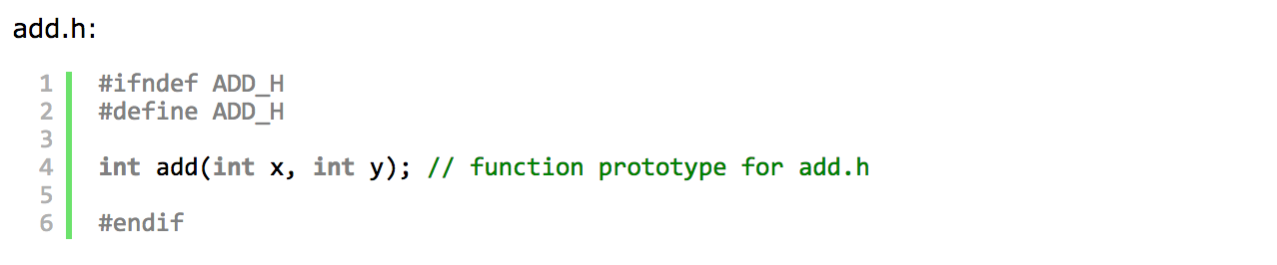
Structure of Header File
header guard

Slide 4
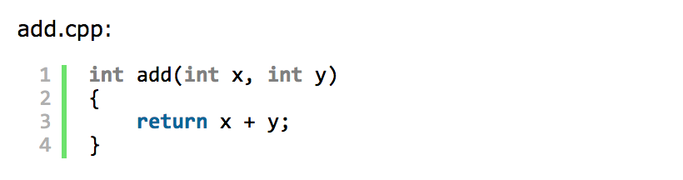
Structure of Implementation File

Slide 5
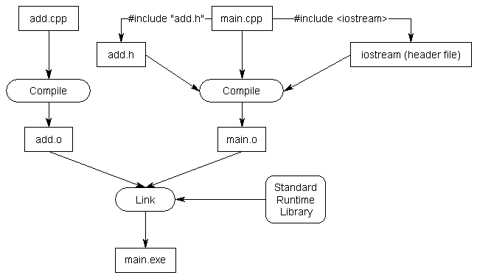
How The Compiler Works

